Slide 1

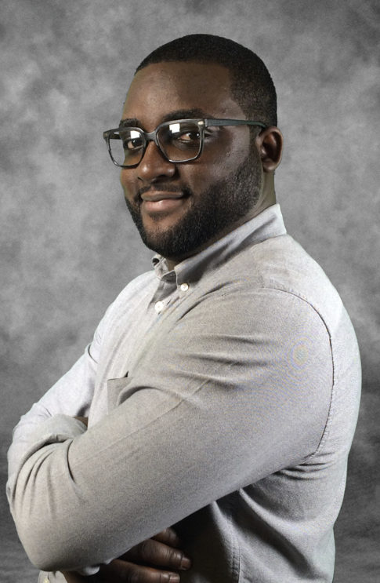


JOIN US AND OUR POWER EXPERTS AT THE
GLOBAL POWER
PLATFORM BOOTCAMP
OFFICIAL EVENT IN LAGOS WITH HANDS-ON SESSIONS AND LABS
15th FEBRUARY 2020
EVENT VENUE & ADDRESS HERE
09:00 AM – 05:00 PM
Samuel Adranyi
Solutions Architect | MCT | Power Addict
@sadranyi
REGISTER FREE HERE: https://registration_link_here
DON’T FORGET TO BRING YOUR LAPTOP AND IDEAS

Slide 2
JOIN US AND OUR POWER EXPERTS AT THE OFFICIAL EVENT IN LAGOS WITH HANDS-ON SESSIONS AND LABS
GLOBAL POWER PLATFORM BOOTCAMP
15th FEBRUARY 2020, EVENT VENUE & ADDRESS HERE, 09:00 AM – 05:00 PM
REGISTER FREE HERE: https://registration_link_here
Samuel Adranyi
Solutions Architect
Samuel Adranyi
Solutions Architect
Samuel Adranyi
Solutions Architect
Samuel Adranyi
Solutions Architect
DON’T FORGET TO BRING YOUR LAPTOP AND IDEAS

Slide 3
JOIN US AND OUR POWER EXPERTS AT THE
GLOBAL POWER PLATFORM
BOOTCAMP, LAGOS 2020
OFFICIAL EVENT IN LAGOS WITH HANDS-ON SESSIONS AND LABS
15th FEBRUARY 2020
EVENT VENUE & ADDRESS HERE
09:00 AM – 05:00 PM
REGISTER FREE HERE: https://registration_link_here
DON’T FORGET TO BRING YOUR LAPTOP AND IDEAS

Slide 4


